Slide 1

A Database Driven Management System
By: Raja Kumail Ali Nasir

Slide 2


Problem Statement
An animal training organization struggles with managing its core operational data. This includes tracking employees, customers, animals, and training schedules.

Slide 3





Objective
Database Application
Develop a robust database management system.
User-Friendly Interface
Provide an intuitive and easy-to-use application.
Efficient Management
Streamline all key organizational information efficiently.
Comprehensive Data
Manage employee, customer, and animal data effectively.
Our objective is to create a user-friendly database application. It will empower the organization to efficiently manage all its key information.

Slide 4
Tools
Languages
Development Tools
Connector
C++: For application logic and user interface.
Visual Studio Code: Code editor for C++ development.
ODBC: API for C++ to SQL Server communication.
SQL: For defining and manipulating database data.
SQL Server Management Studio (SSMS): Manages SQL Server database.
We selected C++ and SQL for development. Visual Studio Code and SSMS are our primary tools. ODBC connects the C++ application to the SQL Server database.

Slide 5
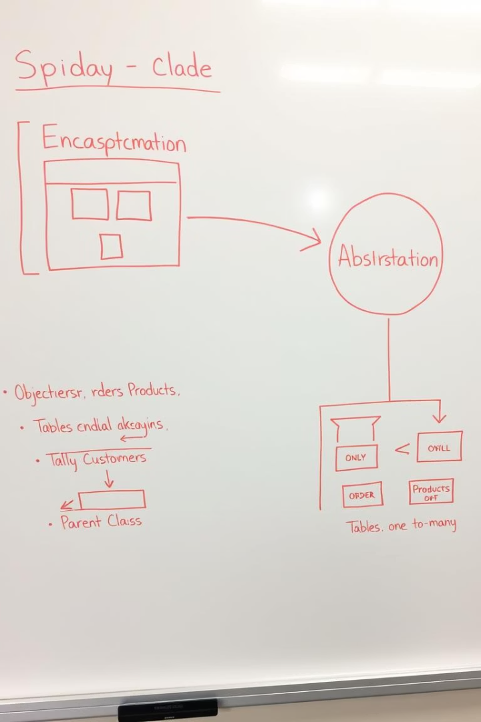


Methodology
C++ (OOP Design)
Encapsulation: Bundling data and methods.
Abstraction: Hiding implementation complexity.
Inheritance: Creating specialized classes from general ones.
SQL (Database Design)
Normalized Schema: Ensures data integrity and reduces redundancy.
Our C++ design uses OOP principles like encapsulation and inheritance. The SQL database features a normalized schema. This ensures data integrity and reduces redundancy effectively.

Slide 6
Classes
Person (Base Class)
The system defines a clear class hierarchy.
--Person is the base class, with Customer and Employee inheriting from it.
--Employee further specializes into Trainer and Worker.
--Additional classes manage Animals, TrainingSessions, and Enrollments.
Customer (Inherits from Person)
Employee (Inherits from Person)
Trainer (Inherits from Employee)
Worker (Inherits from Employee)
Animal
TrainingSession
Enrollment
Links an Animal to a TrainingSession.

Slide 7
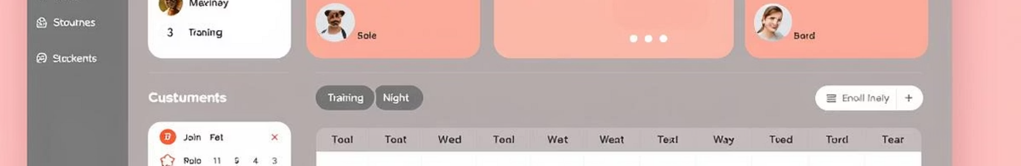
Features
Employee Management
Customer & Animal Management
Add, view, update, and delete employee records.
Register new customers and animals.
Az well as manipulate to customer and animal records.
Enrollment System
Search
Enroll animals into a training program with available trainers.
Allows searching of a specific record of a specific table by a specific attribute.

Slide 8
Conclusion
Centralizing all employee, customer, and animal data.
Streamlining core operations like scheduling and enrollment.
Ensuring data integrity through a robust database design.
Providing a scalable foundation for future growth.
The database management system effectively resolves data challenges. It centralizes all key data and streamlines operations. This ensures data integrity and provides a scalable foundation. The project successfully meets its objectives.

Slide 9


